Slide 1

A RECOMMENDER SYSTEM
Chu Wang
Di You
Saranya Manoharan
Rishitha Kiran
TEAM 12

Slide 2

TEAM 12
BUSINESS
REVIEWS
BUSINESS
TIPS
YELP DATASET
REVIEWS
USERS
USERS
PHOTOS
CHECKIN

Slide 3
BUSINESS PROPOSAL
TEAM 12
Recommend potential friends to users based on Kmeans and second degree relationship
Recommend potential users to business owners using Collaborative Filtering
Top restaurants/shops recommendation in an area using clustering

Slide 4
TEAM 12
WORKFLOW
Recommend restaurants and friends to users
Cleaning the datasets and filtering out restaurants.
Recommend most popular restaurant to user
Recommend users to business owners
Clustering restaurants using K-Means clustering
DATA CLEANING AND FILTERING
CLUSTERING
RESTAURANT RECOMMENDATION
FRIENDS RECOMMENDATION
USER RECOMMENDATION

Slide 5
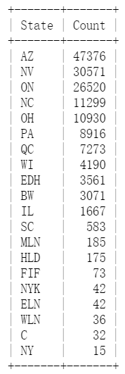
TEAM 12
CLEANING THE DATASETS AND FILTERING OUT RESTAURANTS
BUSINESS
REVIEWS
USERS
156,000 businesses
4,700,000 reviews
1,100,000 users
NORTH CAROLINA
11,299 business
270,000 reviews
70,000 users

Slide 6
TEAM 12
RECOMMENDING TOP RESTAURANTS TO USERS
We define this problem as a clustering mathematics problem.
Input: review count, average rating, percentage of positive ratings and percentage of negative ratings
We define 4,5 to be positive ratings and 1,2 to be negative ratings
Approach : k-means clustering
To determine k we use two methods:
We run k-means on the data set for k =1 to 15 and calculate SSE
We calculate Silhouette coefficient for data without label and NMI for data with label respectively

Slide 7
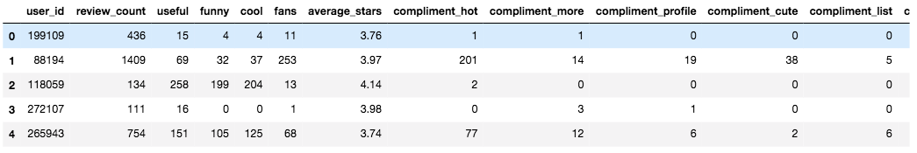
TEAM 12
RECOMMENDING FRIENDS TO USERS
APPROACH 1: BASED ON SIMILARITY METRICS
Input: attributes such as ‘useful’, ‘funny’, ‘cool’, ‘friends’, ‘fans’, ‘review_count’, etc. from the users’ profile
Approach:
Normalize these features with L2 norm, then did Kmeans clustering (k=100) for dimensionality reduction
-Calculate similarity using Cosine similarity within the clusters
-Output 10 most similar friends to each other(cosine sim > 0.9)

Slide 8
TEAM 12
RECOMMENDING FRIENDS TO USERS
APPROACH 2: BASED ON SECOND DEGREE RELATIONSHIP
Input: users list of friends
Approach:
-Build up your network by knowing the friends of your friends user_json[‘friends’], create friends dictionary -Define 1st degree friend as: If A is in B’s friend list, whether B is in A’s list or not, A is friend with B -2nd degree friend: If A is friend with B, B is friend with C, A might also be friend C
level_2_friends_dict[27632]

Slide 9
TEAM 12
RECOMMEND POTENTIAL USERS TO BUSINESS OWNERS USING COLLABORATIVE FILTERING
Input: users rating history
Approach: Collaborative Filtering Based on Latent Factor Model
Example: Consider 2 users X and Y , user X gives positive rating for business A and B , and user Y gives positive rating for business B and C.
For users X and Y business B is common making them similar to one another.
User Y has rated C which user X hasn’t and since X and Y are similar we can suggest business C to user X.
We use latent factor model to check for similarities among the businesses. In latent factor model we consider certain features specific to the domain and based on this similarity measure is calculated.
Collaborative filtering uses this similarity to match users to the business.

Slide 10
TEAM 12
We can sell these services to business owners, this helps them identify their potential customers.
So that they can be more proactive in marketing their services to these customers who are more likely to use their services than marketing it to all users most of whom might never use their services.
This way they can focus on targeted set of users and maximize their profits

Slide 11
TEAM 12
THANK YOU!!

